Slide 1
As you come in:
-> Copy down the date and title from the board.
-> Private reading.
Lesson Objectives
To be able to comment on Collin’s use of flashback and foreshadowing. (AF4)
To be able to recognise examples of the key themes/motifs from chapters 2+3. (AF6)
To be able to empathise with the decisions of the characters.

Slide 2

Theseus and the Minotaur
Notes:
Clicking on picture opens link

Slide 3
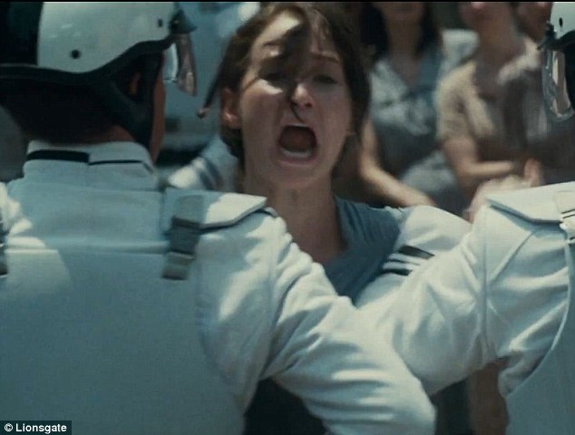
Think-Pair-Share
Were you surprised that Katniss volunteered? Why/why not?
Do you think you would have done the same in her circumstances?
Why do you think that Peeta’s older brother didn’t volunteer?

Slide 4
Key Definition
Flashback: an interjected scene that takes
the narrative back in time from the current
point the story has reached.
Think-Pair-Share
What did we learn from the flashback about
Peeta? Why do you think it has been
included?

Slide 5
Column 1 –Prim
Column 2 – Mother
Column 3 – Madge
Column 4 – Gale
Brainstorm in your book how you think your character would feel watching Katniss leave.

Slide 6
Homework
Write a diary entry for the character your table studied in the lesson for the day of the reaping. It should be at least half a side of A4.
Due in next Monday

